Slide 1
Artificial Neural Network
For BCSE Final Year
Jadavpur University

Slide 2
Trainable Pattern Classifiers-The Deterministic Approach
Here we would study classifiers whose decision functions are generated from training patterns by means of iterative, "learning" algorithms. We know that once a type of decision function has been specified, the problem is the determination of the coefficients. Here some algorithms would be discussed that are capable of learning the solution coefficients from the training sets whenever these training pattern sets are separable by the specified decision functions.

Slide 3
Contd…
Frank Rosenblatt (1962) introduced the most primitive type of trainable pattern classifier in the form of a Artificial Neural Network (ANN) which is known as Single-Layer-Perceptron (SLP).

Slide 4
What is a Neural Network ?
A prototype nerve cell called neurone is shown below. Electrical impulses propagating along the axon (axon potentials) activate the synaptic junctions. These, in turn, produce further excitations (post synaptic potentials) which travel along the dendrites towards the next neurone

Slide 5
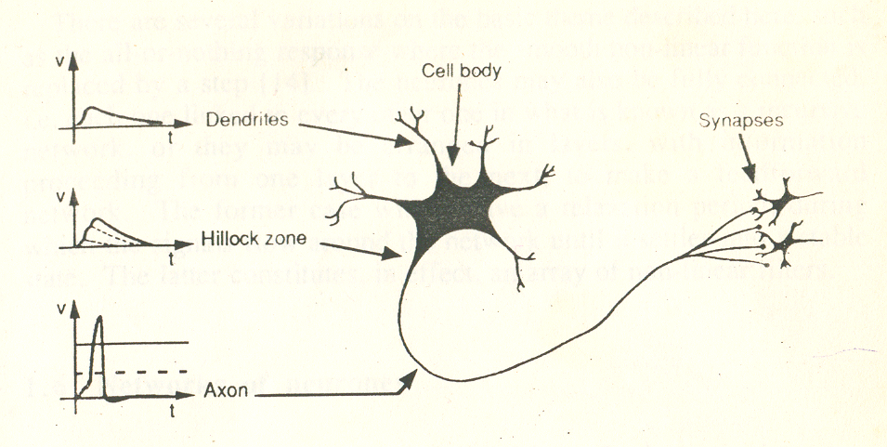
Contd…
-
Figure 1. A prototype neurone

Slide 6
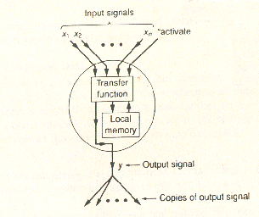
A Neural Processing Element
-
Figure 2. A neural processing element

Slide 7
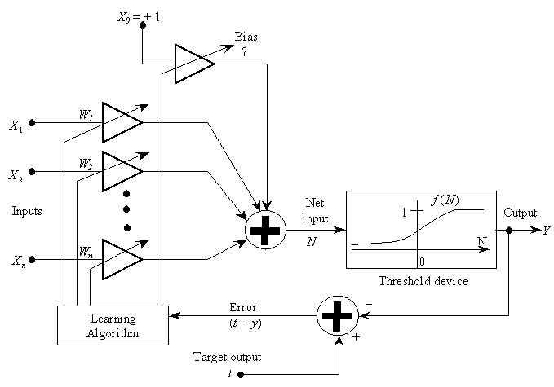
Another typical model of neurone
-
Figure 3. Another typical model of neurone

Slide 8
Contd…
The firing rate of each neurone is controlled by the region where the axon joins the cell body, called the hillock zone . When the membrane potential at the hillock zone rises above a certain threshold value around -60 mV, it causes a travelling wave of charge to propagate. The neurone must restore itself to its proper resting state of balance before sending out the next packet of charge, called the refractory period.

Slide 9
Contd…
So information is passed via synapses. The synapses are termed excitatory, or inhibitory depending on whether the post-synaptic potentials increase or reduce the hillock potential, enhancing or reducing the likehood of triggering an impulse there respectively.

Slide 10
Contd…
The current level of understanding of the brain function is so primitive that not even one area of brain is yet completely understood. Thus artificial neural network only tries to mimic the biological neural network in a very crude and primitive manner.

Slide 11
What is a ANN ?
An artificial neural network is a paralled distributed information processing structure in the form of a directed graph, with the following sub-definitions and restrictions which are given in next slide.

Slide 12
Contd…
The nodes of the graph are called processing elements.
The links of the graph are called connections. Each connection function as an instantaneous unidirectional signal-condition path.
Each processing element can receive any number of incoming connections (also called input connections).

Slide 13
Contd…
Each processing element can have any number of outgoing connections, but the signals in all of these must be the same.
Processing elements can have local memory.
Each processing element possesses a transfer function, which can use (and alter) local memory, can use input signals, and which produces the processing element's output signal.

Slide 14
Contd…
Transfer functions can operate continuously or episodically. If they operate episodically, there must be an input called “activate” that causes the processing element's transfer function to operate on the current input signals and local memory values and to produce and update output signal (and possibly to modify local memory values). Continuous processing elements are always operating. The “activate” input arrives via a connection from a scheduling processing element that is part of the network.

Slide 15
Contd…
Input signals to a neural network from outside the network arrive via connection that originate in the outside world. Outputs from the network to the outside world are connections that leave the network.

Slide 16
Contd…
The input signals x₁,x₂….,x_{n} arriving at the processing element are supplied to the transfer function, as is the "activate" input. The transfer function of an episodically updated processing element, when activated, uses the current values of the input signals, as well as values in local memory, to produce processing element's new output signal value y.

Slide 17
Contd…
Note that the strength of each synaptic junction is represented by a multiplicative factor, or weight with a positive sign for excitatory connections, and negative otherwise. The hillock zone is modeled by a summation of the signals received from every link. The firing rate of the neurone in response to the aggregate signal is then described by a mathematical function, whose value represents the frequency of emission of electrical impulses along the axon.

Slide 18
Contd…
The general artificial neuron model has five components, shown in the following list. (The subscript i indicates the i-th input or weight.)
A set of inputs X_{i},
A set of weights W_{i},
A bias Θ
An activation function, f.
Neuron output, Y

Slide 19
Table 1: A comparison of neural networks and conventional computers.
Neural network Conventional computers
Many simple processors Few complex processors
Few processing steps Many computational Steps
Distributed processing Symbolic processing

Slide 20
Contd…
Trained by example Explicit programming

Slide 21
Contd…
Algorithms Type Function
Hopfield recursive optimization
Multi-layered feedforward classification perceptron
Kohonen self-organizing data coding
Temporal predictive forecasting differences

Slide 22
A taxonomy of six neural nets that can be used as classifiers.
NEURAL NET CLASSIFIERS
-
BINARY INPUT
CONTINUOUS-VALUED INPUT
SUPERVISED
UNSUPERVISED
SUPERVISED
UNSUPERVISED
HOPFILED
NET
HAMMING
NET
PERCEPTRON
MULTI-LAYER
PERCEPTRON
CARPENTER/
CROSSBERG
CLASSIFIER
KOHONEN
SELF-ORGANIZING
FEATURE MAP
OPTIMUM CLASASIFIER
LEADER CLUSTRING ALGORITHM
GAUSSIAN CLASSIFIER
K-NEAREST NEIGHBOR, MIXHURE
K-MEANS CLUSTRING ALGORITHM

Slide 23
Single Layer Perceptron
The single layer perceptron consists with only one node that can be used with both continuous valued and binary inputs. A perceptron that decides whether an input belongs to one of two classes (denoted A or B) is shown below. The single node computes a weighted sum of the input elements, subtracts a threshold (Θ) and passes the result through a hard limiting nonlinearity such that the output y is either +1 or -1. for class A and class B respectively.

Slide 24
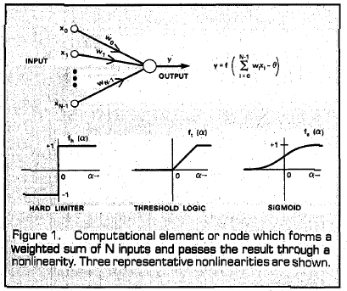
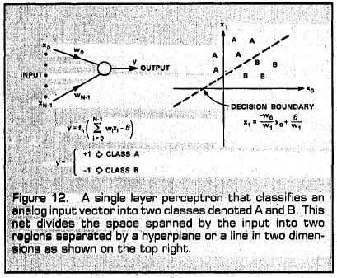
Contd…
-

Slide 25
Contd…
The perceptron forms two decision regions separated by a hyperplane which in 2-D is a line. As can be seen, the equation of the boundary line depends on the connection weights and the threshold.

Slide 26
Contd…
Connection weights and the threshold in a perceptron can be fixed or adapted using a number of different algorithms. The original perceptron convergence procedure for adjusting weights was developed by Rosenblatt. It is described in next slide.

Slide 27
Contd…
First connection weights and the threshold value are initialized to small random non-zero values. Then a new input with N continuous valued elements is applied to the input and the output is computed as in Fig. 12. Connection weights are adapted only when an error occurs using the formula in step 4. This formula includes a gain term that ranges from 0.0 to 1.0 and controls the adaptation rate.

Slide 28
The Perceptron Convergence Procedure
Step 1. Initialize weights and Threshold
Set W_{i}(0):(0≤i≤N-1) and Θ to small random values.
Here W_{i}(t) is the weight from input i at time t and Θ is the threshold in the output mode.

Slide 29
Contd…
Step 2. Present New Input and Desired Output
Present new continuous valued input X₀,X₁,…X_{N-1}along with the desired output d(t).

Slide 30
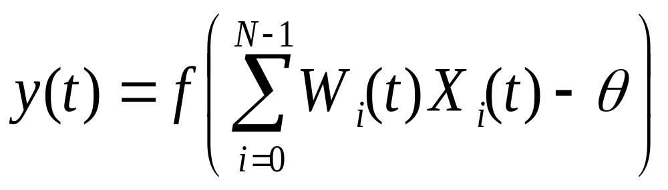
Contd…
Step 3. Calculate Actual Output

Slide 31
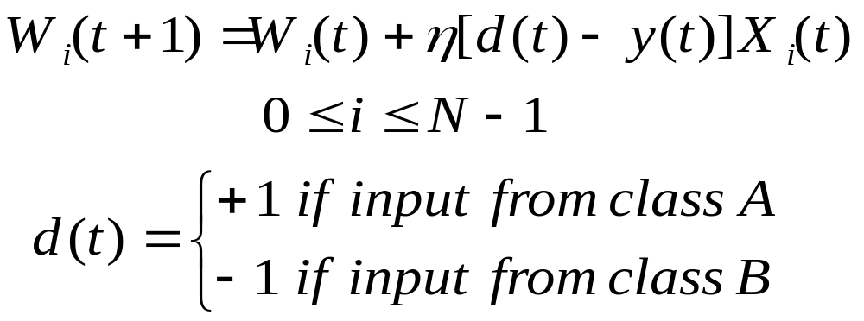



Contd…
Step 4. Adapt Weights
In these equations
is a positive gain fraction less than 1 and
is the desired correct output
for the current input. Note that weights are unchanged if the correct decision
is made by the net.

Slide 32
Contd…
Step 5. Repeat by Going to Step 2.
Note that the gain term must be adjusted to satisfy the conflicting requirements of fast adaptation for real changes in the input distributions and averaging of past inputs to provide stable weight estimates.

Slide 33
Contd…
Rosenblatt proved that if the inputs presented from the two classes are separable (that is they are in opposite sides of some hyperplane), then the perceptron convergence procedure converges and positions the decision hyperplane between those two classes.

Slide 34
Contd…
One problem with the perceptron convergence procedure is that decision boundaries may oscillate continuously when inputs are not separable and distributions overlap.

Slide 35
Multi-Layer Perceptron
Multi-layer perceptrons are feed-forward nets with one or more layers (called hidden layers) of nodes between the input and output nodes. A three-layer perceptron with two layers of hidden units is shown below. Multi-layer perceptrons overcome many of the limitations of single-layer perceptron, and shown to be successful for many problems of interest.

Slide 36
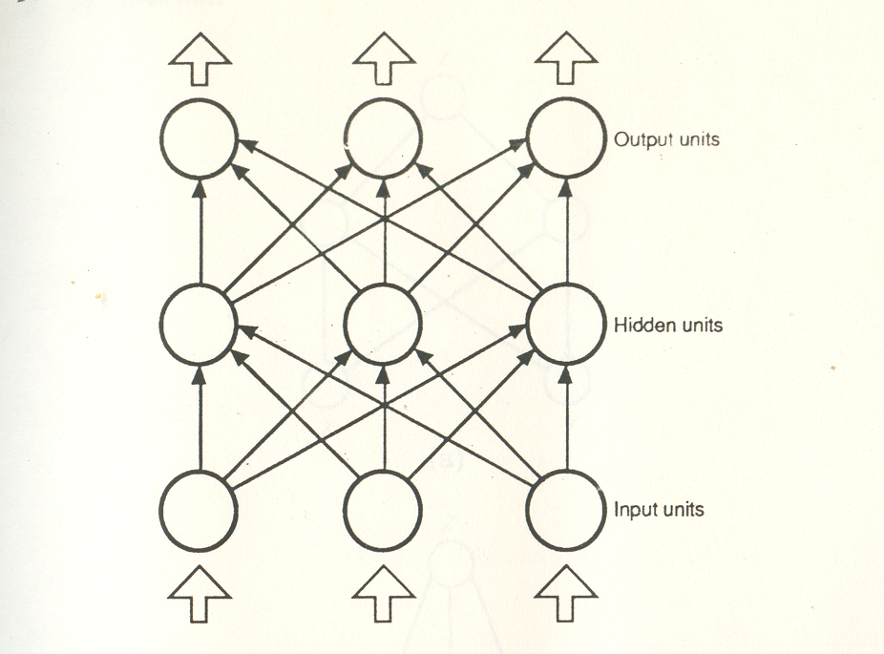
A MLP with one hidden layer
-

Slide 37
Contd…
The capabilities of perceptrons with one, two, and three layers that use hard-limiting nonlinearities are illustrated in the above Figure. The second column in this figure indicates the types of decision regions that can be formed with different nets. The next two columns present examples of decision regions which could be formed for the exclusive OR problem and a problem with meshed regions. The rightmost column gives examples of the most general decision regions that can be formed.

Slide 38
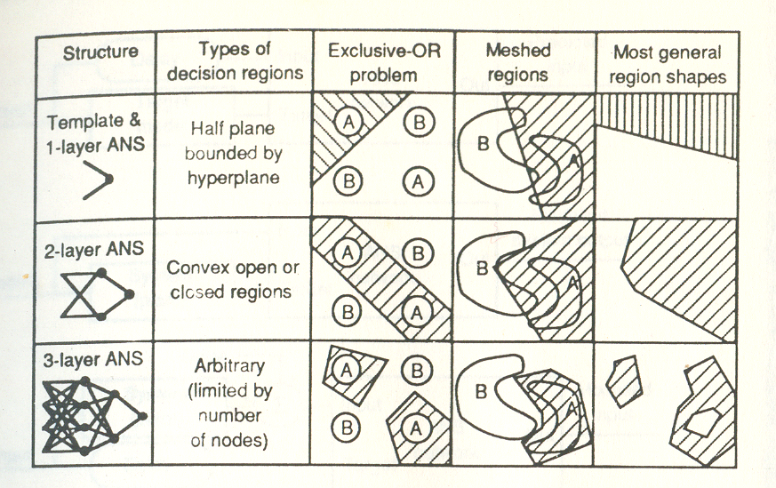
Pattern classification using MLP

Slide 39
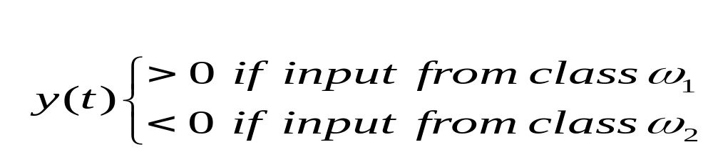
Contd…
The decision boundary provided by SLP is given by
Letting , Θ=0, we get

Slide 40
Contd…
In other words, we want to find a solution weight vector W with the property that W’X>0 for all patterns of ω₁ and W’X<0 for all patterns of ω₂. ……………………………(1)
If the patterns of ω₂ are multiplied by -1, we obtain the equivalent condition W’X>0 for all patterns.

Slide 41
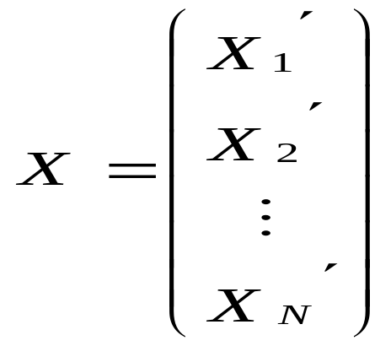
Contd…
Letting N represent the total number of augmented sample patterns in both classes, we may express the problem as one of finding a vector W such that the system of inequalities
W’X>0 ………………….(2) is satisfied,
where

Slide 42
Contd…
W=(w₁,w₂,…..w_{n},w_{n+1})’ and 0 is the zero vector.
If there exists a W which satisfies expression (2), the inequalities are said to be consistent; otherwise, they are inconsistent.

Slide 43
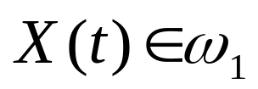
Contd…
Following the condition given in (1), the Perceptron Algorithm is given by
If and W’(t)X(t)>0, let
W(t+1)=W(t)
Otherwise replace W(t) by W(t+1)=W(t)+ η X(t) where η is the correction factor.

Slide 44

Contd…
If and W’(t)X(t)<0, let
W(t+1)=W(t)
Otherwise replace W(t) by W(t+1)=W(t)- ηX(t)
Here the amount of weight correction is not proportional to the amount of error, but a constant fraction of the input being misclassified.

Slide 45
Problem..
Apply the perceptron algorithm to the following augmented patterns to find a solution weight vector for a two class problem.
The classes are ω₁:{(0,0,1)’,(0,1,1)’} and ω₂:{(1,0,1)’,(1,1,1)’}
Letting η=1 and W(1)=0, and presenting the patterns in the above order, results in the following sequence of steps:

Slide 46
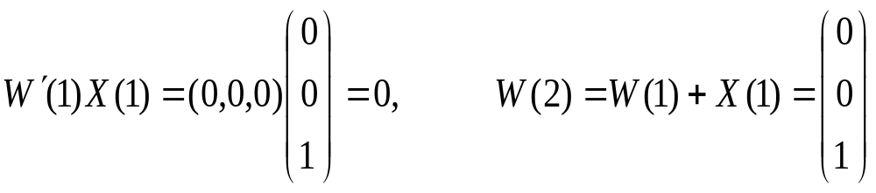
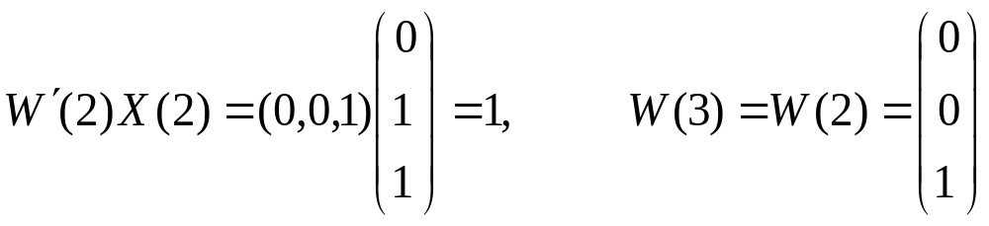
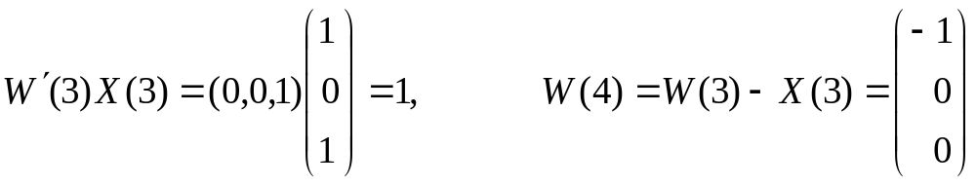
Contd…
-

Slide 47
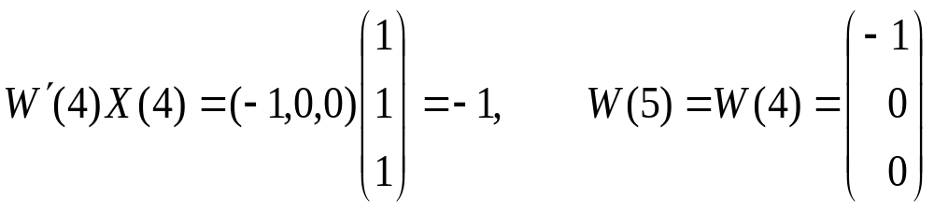
Contd…
where corrections on the weight vector were made in the first and third steps because of misclassification, Since a solution has been obtained only when the algorithm yields a complete, error-free iteration through all patterns, the training set must be presented again.

Slide 48
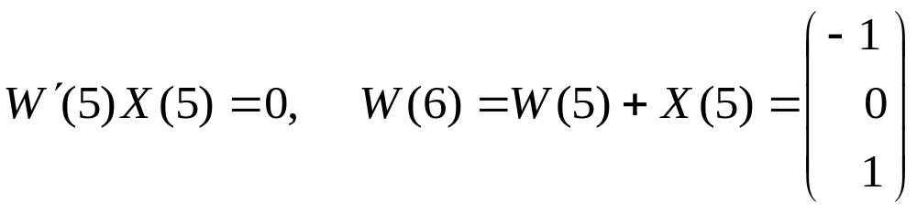
Contd…
The machine learning process is continued by letting X(5)=X(1),X(6)=X(2),X(7)=X(3) and X(8)=X(4) The second iteration through the patterns yields:

Slide 49
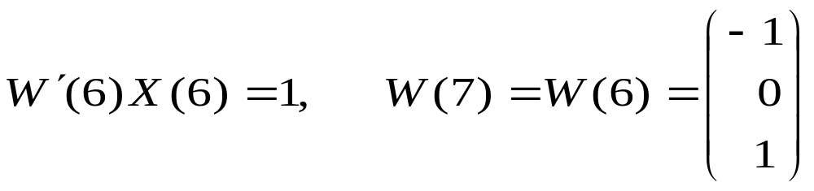
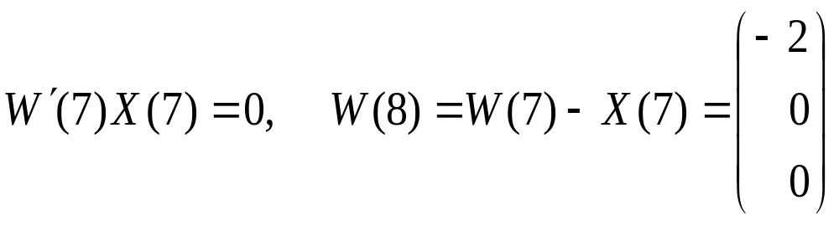
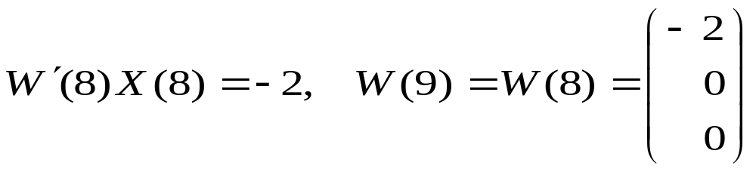
Contd…
-

Slide 50
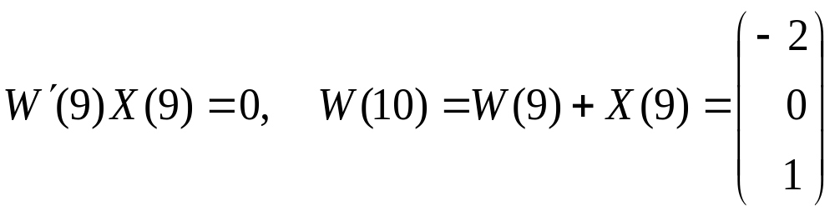
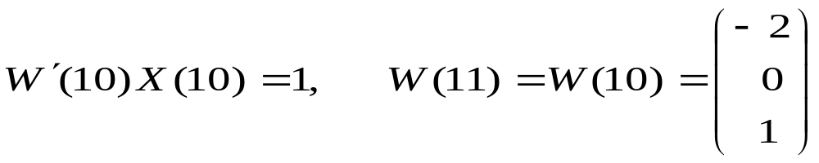
Contd…
Since two errors occurred in this iteration, the patterns are presented again.

Slide 51
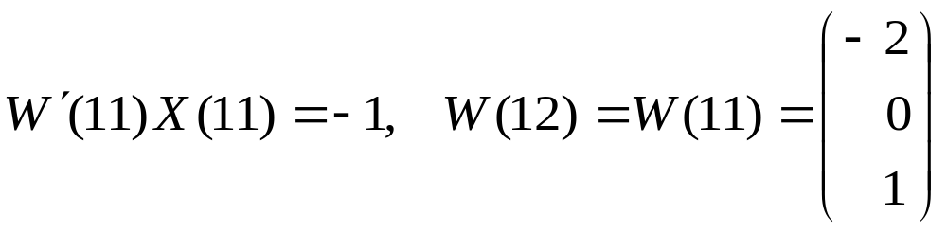
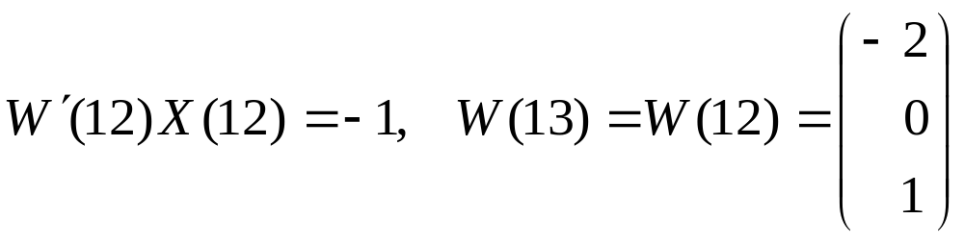
Contd…
-

Slide 52
Contd…
It is easily verified that in the next iteration all patterns are classified correctly. The solution vector is, therefore,W=(-2,0,1)’ The corresponding decision function is d(X)=-2x₁+1which, when set equal to zero, becomes the equation of the decision boundary shown in Figure below.

Slide 53
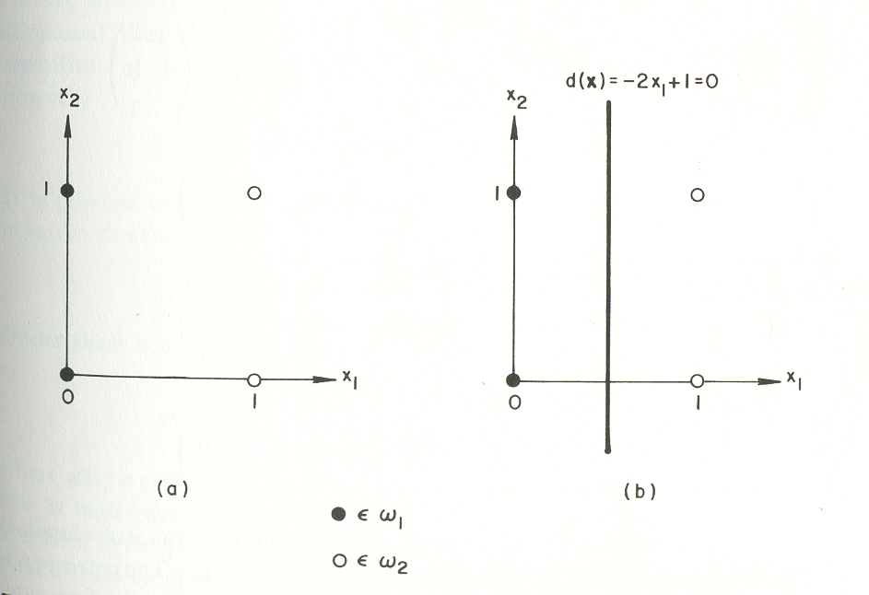
(a) Patterns belonging to two classes. (b) Decision boundary determined by training
-

Slide 54
Contd…
According to Eq.(2), we may express the perceptron algorithm in an equivalent form by multiplying the augmented patterns of one class by - 1. Thus, arbitrarily multiplying the patterns of ω₂ by - 1, we can write the perceptron algorithm as

Slide 55
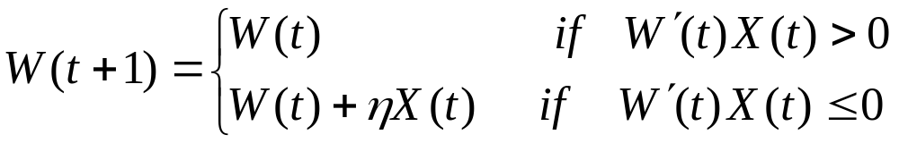
Contd…
where η is a positive correction increment.

Slide 56
THANK YOU

